Slide 1

Spam Email Detection
Using Classification Method-- Bayesian Decision and Support Vector Machine
Team: Hao Wu; Jingya Liu

Slide 2
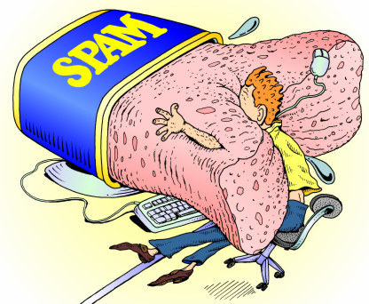
Spam Does Matter
Email brings us convenient to communicate and delivery vital messages, however, there are huge amount of emails with both spam and ham which waste our time to browse and even fail to have a look at important email.
Hence, how to detect those spams and filter them efficiently is much more significant.

Slide 3





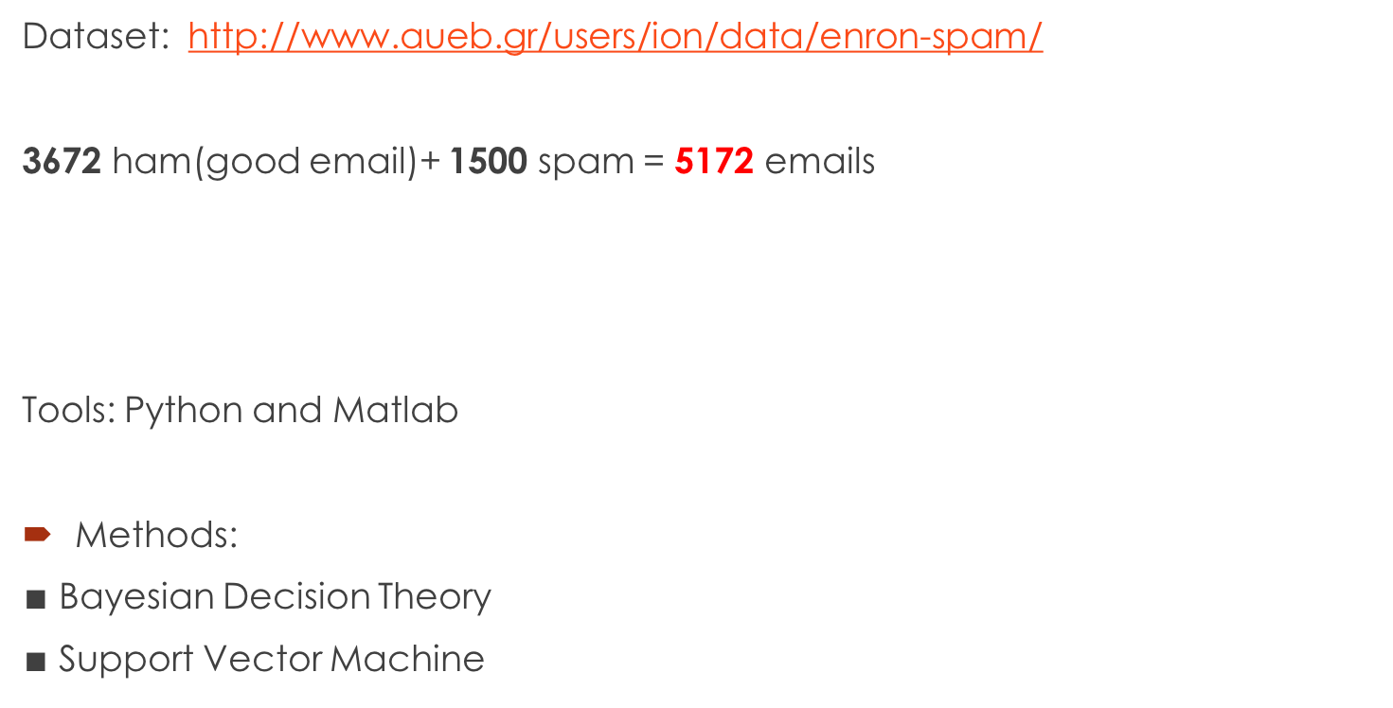
Dataset: http://www.aueb.gr/users/ion/data/enron-spam/
3672 ham(good email)+ 1500 spam = 5172 emails
Tools: Python and Matlab
Methods:
$∎$ Bayesian Decision Theory
$∎$ Support Vector Machine

Slide 4
Methods-- Bayesian Decision Theory
(1). P(t)=CT/TN
CT: Term Count in the Category(how many emails contain the term in the category)
TN: Total Number of Emails in the Category
Category: Ham and Spam
(2). Build Probability Model
Mspam Mham
-- P(t1|Ms) -- P(t1|Mh)
-- P(t2|Ms) -- P(t2|Mh)
…... ......
-- P(tn|Ms) -- P(tn|Mh)
P(E|Ms or Mh)= P(t1|M)*P(t2|M)…...P(tn|M)

Slide 5
(3). Zero Frequency problem
The email in training set may contain new words not in our Model
Solve: Dirichlet Prior Smoothing
totals: is total number in documents( all category)
u=1
P(t|REF) =0.5

Slide 6
(4). Classification
Now we know P(E|Ms)
Use Bayesian Rule:
P(Ms|E)=P(E|Ms)P(Ms)
P(Mh|E)=P(E|Mh)P(Mh)
Simply we can do this:
if P(Ms|E)> P(Mh|E) , then classify Spam
else classify Ham

Slide 7
(5). Bayes Risk
Action
Real
Take new Email as Spam When:
R(spam|E)<R(ham|E)
 | Spam | Ham
Spam | 0 | 1
Ham | 3 | 0

Slide 8
Accuracy of Bayesian Decision
Training set: 1034
Right classification: 946
Accuracy Rate: 91.49%

Slide 9
Support Vector Machine(SVM)
1. Assume every words in email is a feature
2. However, there will be enormous words
What we do is to take some special words and characters based on other researchers’ experience.
make; address; all; 3d; over; remove; internet;
order; mail; receive; will; money;’!’;’#’…......

Slide 10

3. New data set for Matlab
Count these 66 words frequency in each email, if the words not exist in the email, give 0 frequency.

Slide 11
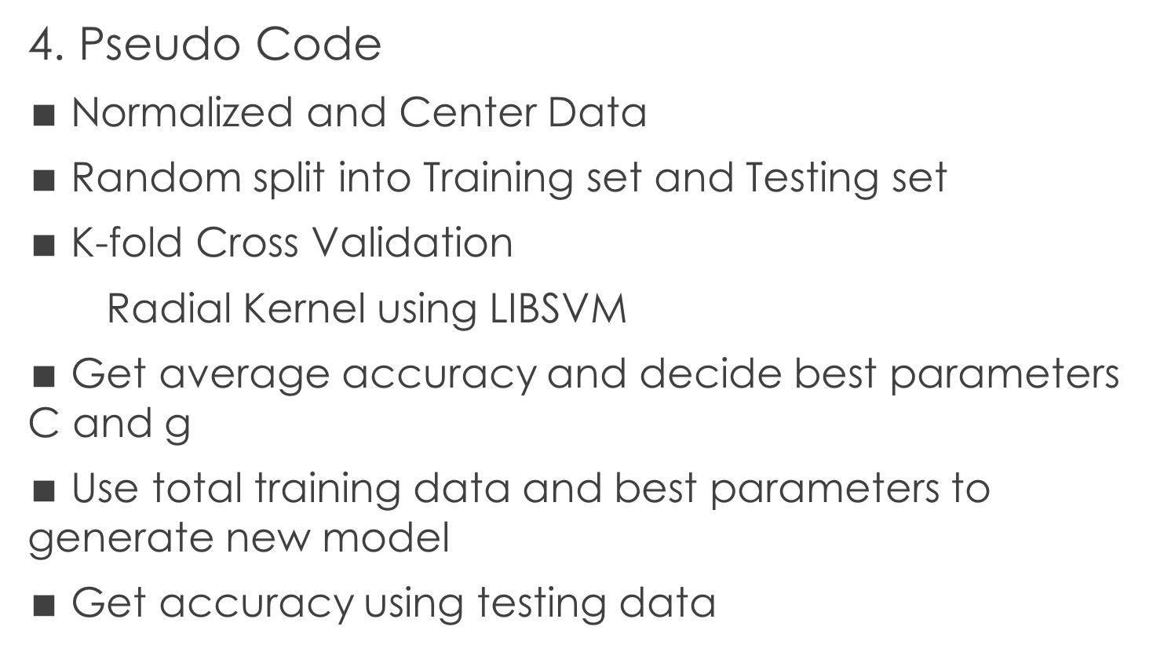
4. Pseudo Code
$∎$ Normalized and Center Data
$∎$ Random split into Training set and Testing set
$∎$ K-fold Cross Validation
Radial Kernel using LIBSVM
$∎$ Get average accuracy and decide best parameters C and g
$∎$ Use total training data and best parameters to generate new model
$∎$ Get accuracy using testing data

Slide 12
Accuracy of SVM
C(cost)=1000
G(gamma)=0.1
Accuracy= 87.3308%

Slide 13
Future Vision
For Bayesion Decision, instead of using pre-assign probability 0.5, we can use other researchers’ result as pre-assign probability. We may also do cross validation to train best lambda.
For SVM, we could try to get all words in the collection as features instead of using some special words. SVM supports high dimension features.

Slide 14
Reference
Programing, Collective Intelligence, by O’Reilly
http://www.forbes.com/sites/firewall/2010/03/17/the-most-common-words-in-spam-email/
https://archive.ics.uci.edu/ml/machine-learning-databases/spambase/spambase.names
Shweta,R(2013). Designing Spam Model- Classification Analysis using Decision Trees, International Journal of Computer Applications, Volume 75, No.10

Slide 15
Thank you!
Questions?

